Slide 1


TRACK AND TRACE SUPPLY CHAIN
Batch Number: 213
Under the Supervision of,
Prof. Dr. Abdul Khadar A
Professor / Associate Professor / Assistant Professor
School of Computer Science and Engineering
Presidency University
Roll Number | Student Name
20211CSE0849 | Abhinav Kumar Singh
20211CSE0862 | Sourav Bhowmick
20211CSE0830 | Aaditya Kumar
20211CSE0878 | Aditya Kumar Jha
Name of the Program: B.tech Computer Science and Engineering
Name of the HoD: Dr Asif Mohammad H B
Name of the Program Project Coordinator: Mr. Amarnath J.L
Name of the School Project Coordinators: Dr. Sampath A K / Dr. Abdul Khadar A / Mr. Md Ziaur Rahman

Slide 2
.
TRACK AND TRACE SUPPLY CHAIN
Content :
Problem Statement
GitHub Link
Analysis of Problem Statement
Timeline of the Project
References

Slide 3
.
TRACK AND TRACE SUPPLY CHAIN
Problem Statement Number:
Organization: Hindustan Unilever Limited
Category (Hardware / Software / Both): Software
Problem Description: Every year Millions of units of consumer products are transported from farms to factories to distributors to retailers and finally the end consumer. To deliver Quality and transparency, Organizations need to be able to trace each product to its origin. The challenge is to design a solution to track each of the millions of units from point of origin to retailer. The design should need minimal human effort.
Difficulty Level: Complex

Slide 4
TRACK AND TRACE SUPPLY CHAIN
GitHub Link:
https://github.com/abhinavs5040/Track-and-Trace-Supply-chain-project-.git

Slide 5
.
TRACK AND TRACE SUPPLY CHAIN
Analysis of Problem Statement
The goal is to track millions of consumer product units from their point of origin to the retailer with minimal human effort. Traditional barcode-based solutions are insufficient, so we need a more advanced, scalable system that can handle the complexity of tracking across the supply chain.
Key Features Required:
Tracking of individual units from point of origin to retailers.
Scalability to handle millions of units.
Minimal human intervention.
Integration with existing supply chain systems.
Real-time data collection, analysis, and reporting.

Slide 6
.
TRACK AND TRACE SUPPLY CHAIN
Analysis of Problem Statement (contd...)
5. Data Storage and Syncing
Realm or SQLite: For local offline data storage on the mobile app, allowing the app to work even when the device is not connected to the internet.
Redux-Persist: To persist the state of the app locally, ensuring that tracking data is available offline and synced when the app goes online.
6. Real-Time Data Processing
Apache Kafka or RabbitMQ: For streaming real-time data such as product movement and tracking events.
Socket.io: For real-time updates to the React Native app, pushing notifications when there is a product status change.
7. Security
OAuth 2.0 / JWT (JSON Web Tokens): For secure user authentication and authorization between the mobile app and backend services.
SSL/TLS Encryption: For ensuring secure data transmission between the mobile app and backend.
React Native Keychain: For securely storing sensitive data like API keys, tokens, and passwords on the device.

Slide 7
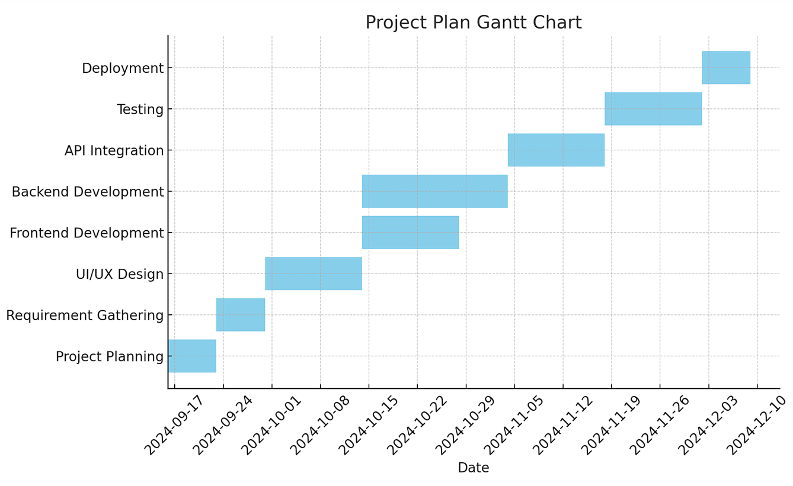
.
TRACK AND TRACE SUPPLY CHAIN
Timeline of the Project (Gantt Chart)

Slide 8
TRACK AND TRACE SUPPLY CHAIN
References (IEEE Paper format)
Here are a few key references in APA style for the main technologies and tools used in the project:
Facebook, "React Native Documentation," 2023. [Online]. Available: https://reactnative.dev/. [Accessed: 17-Sep-2024].
Node.js Foundation, "Node.js Documentation," 2023. [Online]. Available: https://nodejs.org/en/docs/. [Accessed: 17-Sep-2024].
MongoDB, Inc., "MongoDB Documentation," 2023. [Online]. Available: https://www.mongodb.com/docs/. [Accessed: 17-Sep-2024].
Amazon Web Services, "AWS Lambda Documentation," 2023. [Online]. Available: https://docs.aws.amazon.com/lambda/. [Accessed: 17-Sep-2024].
Google Cloud, "Firebase Documentation," 2023. [Online]. Available: https://firebase.google.com/docs. [Accessed: 17-Sep-2024].
Docker, Inc., "Docker Documentation," 2023. [Online]. Available: https://docs.docker.com/. [Accessed: 17-Sep-2024].

Slide 9


